Slide 1

The Future is Yours

Slide 2
1
Why JHU?
Explore Engineering Innovation Overview
Biomedical Engineering Innovation Overview
Sustainable Energy Engineering Overview
Application Process
Eligibility Requirements
2
3
4
5
6

Slide 3
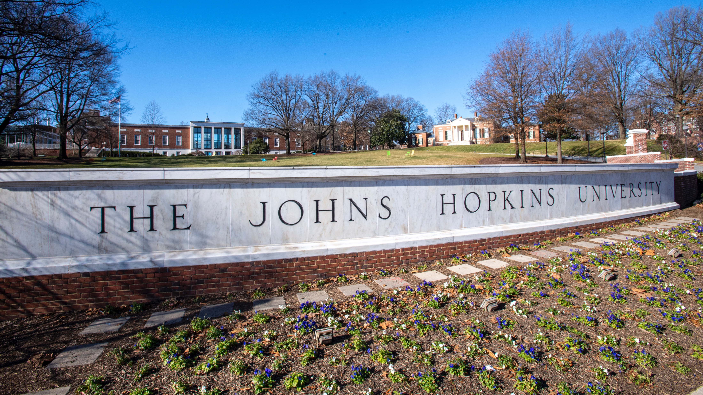

Slide 4


Ranked by
U.S. News
& World Report
America’s first
research university
Associated with the
Johns Hopkins University
Applied Physics Laboratory
Pursuing knowledge
and discovery for the
benefit of the world

Slide 5
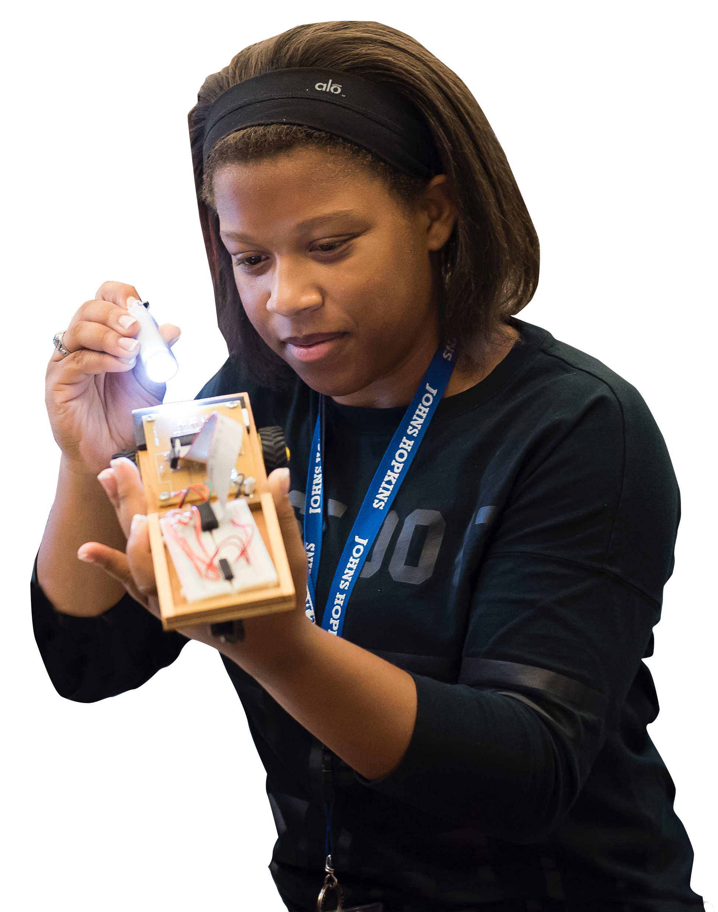

Slide 6
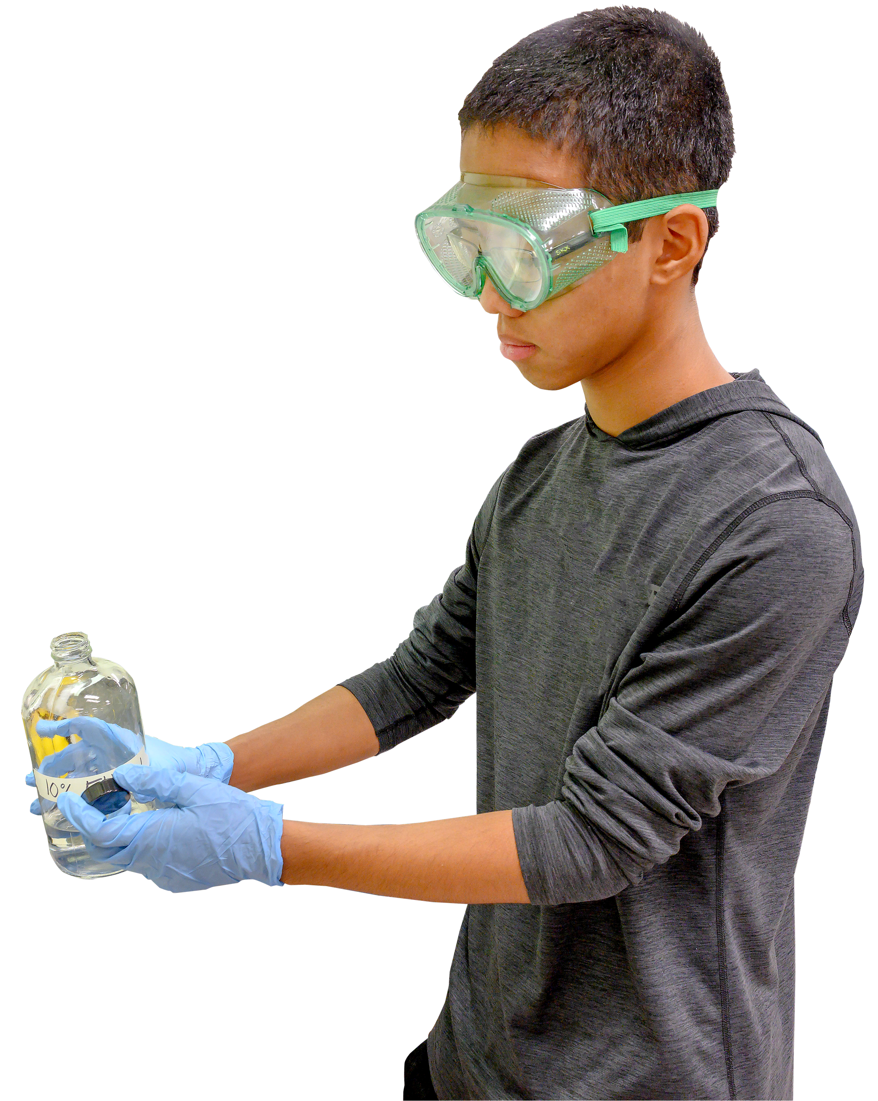

Slide 7
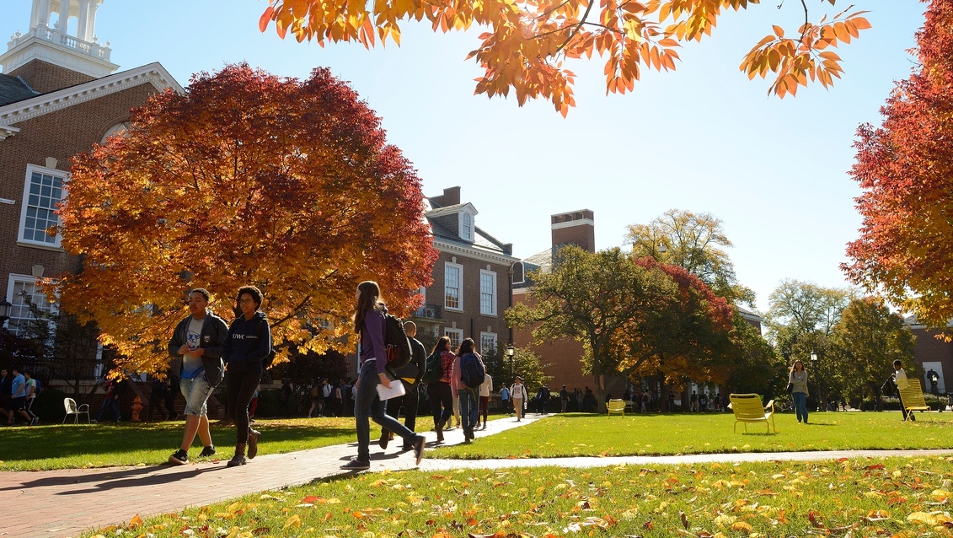

Slide 8
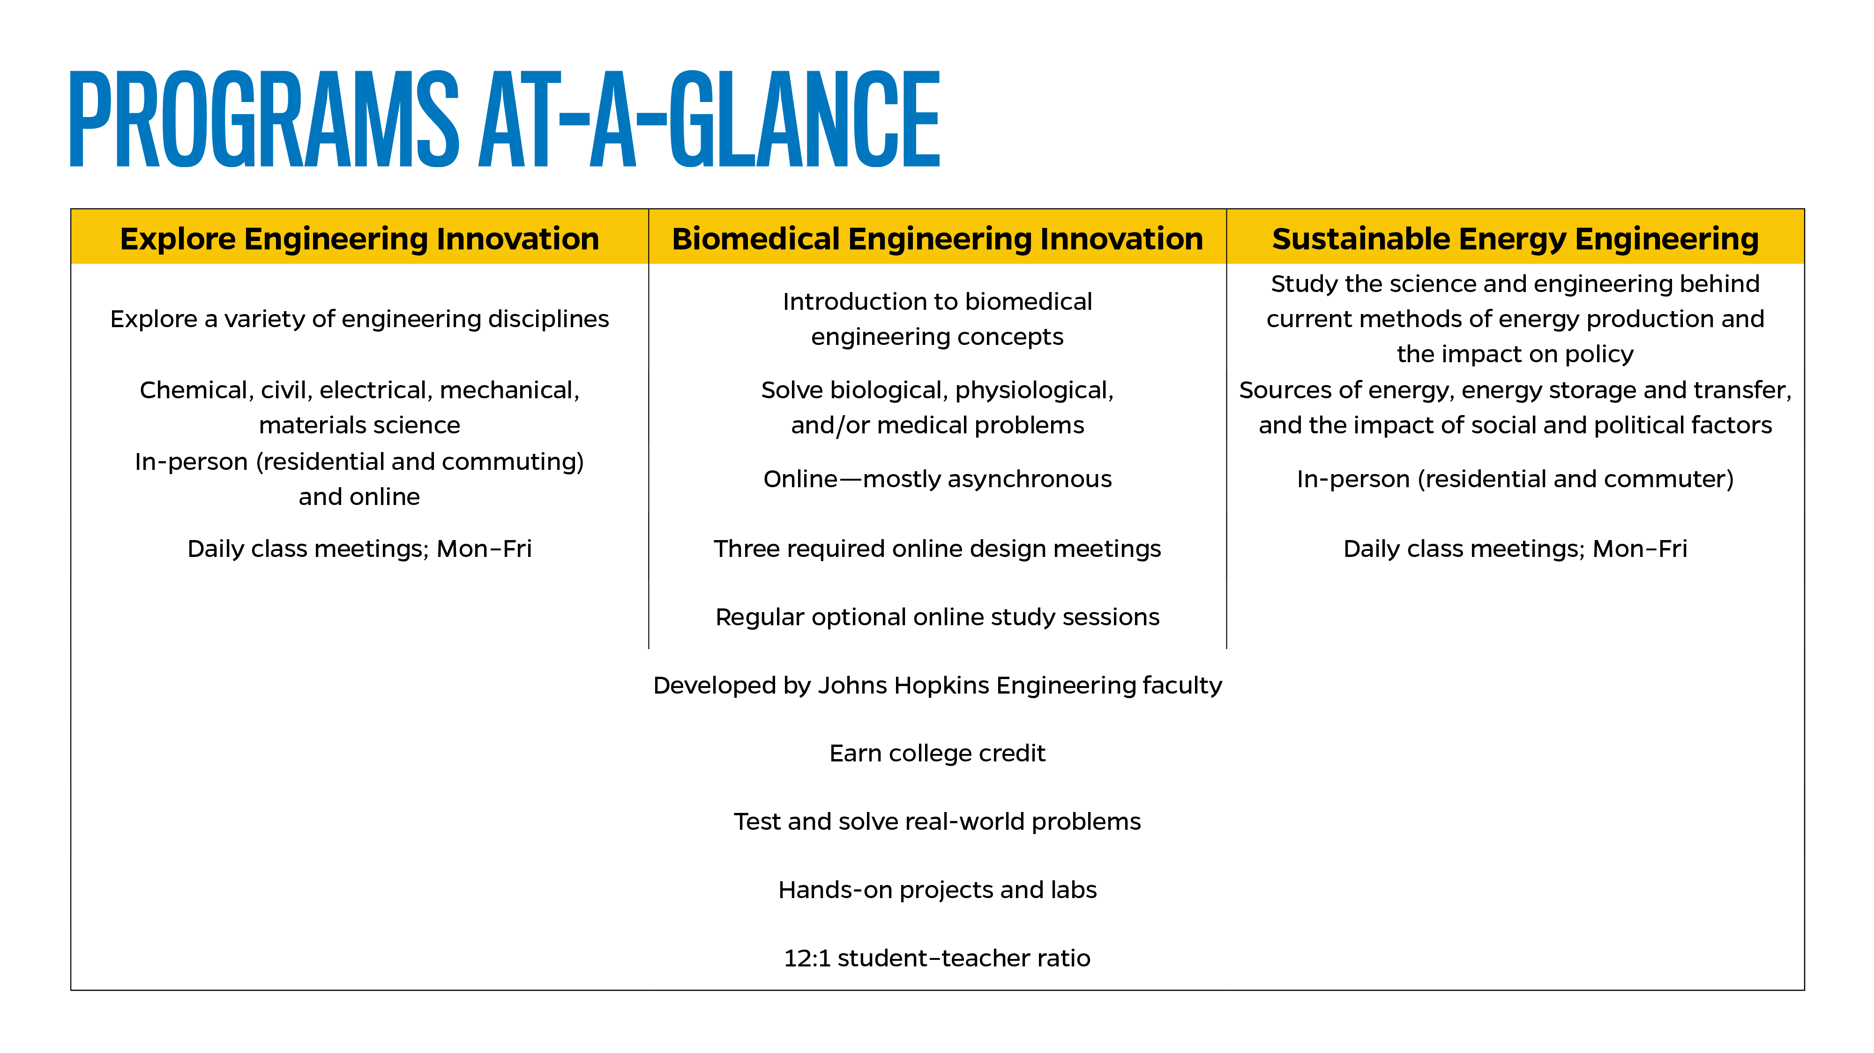

Slide 9
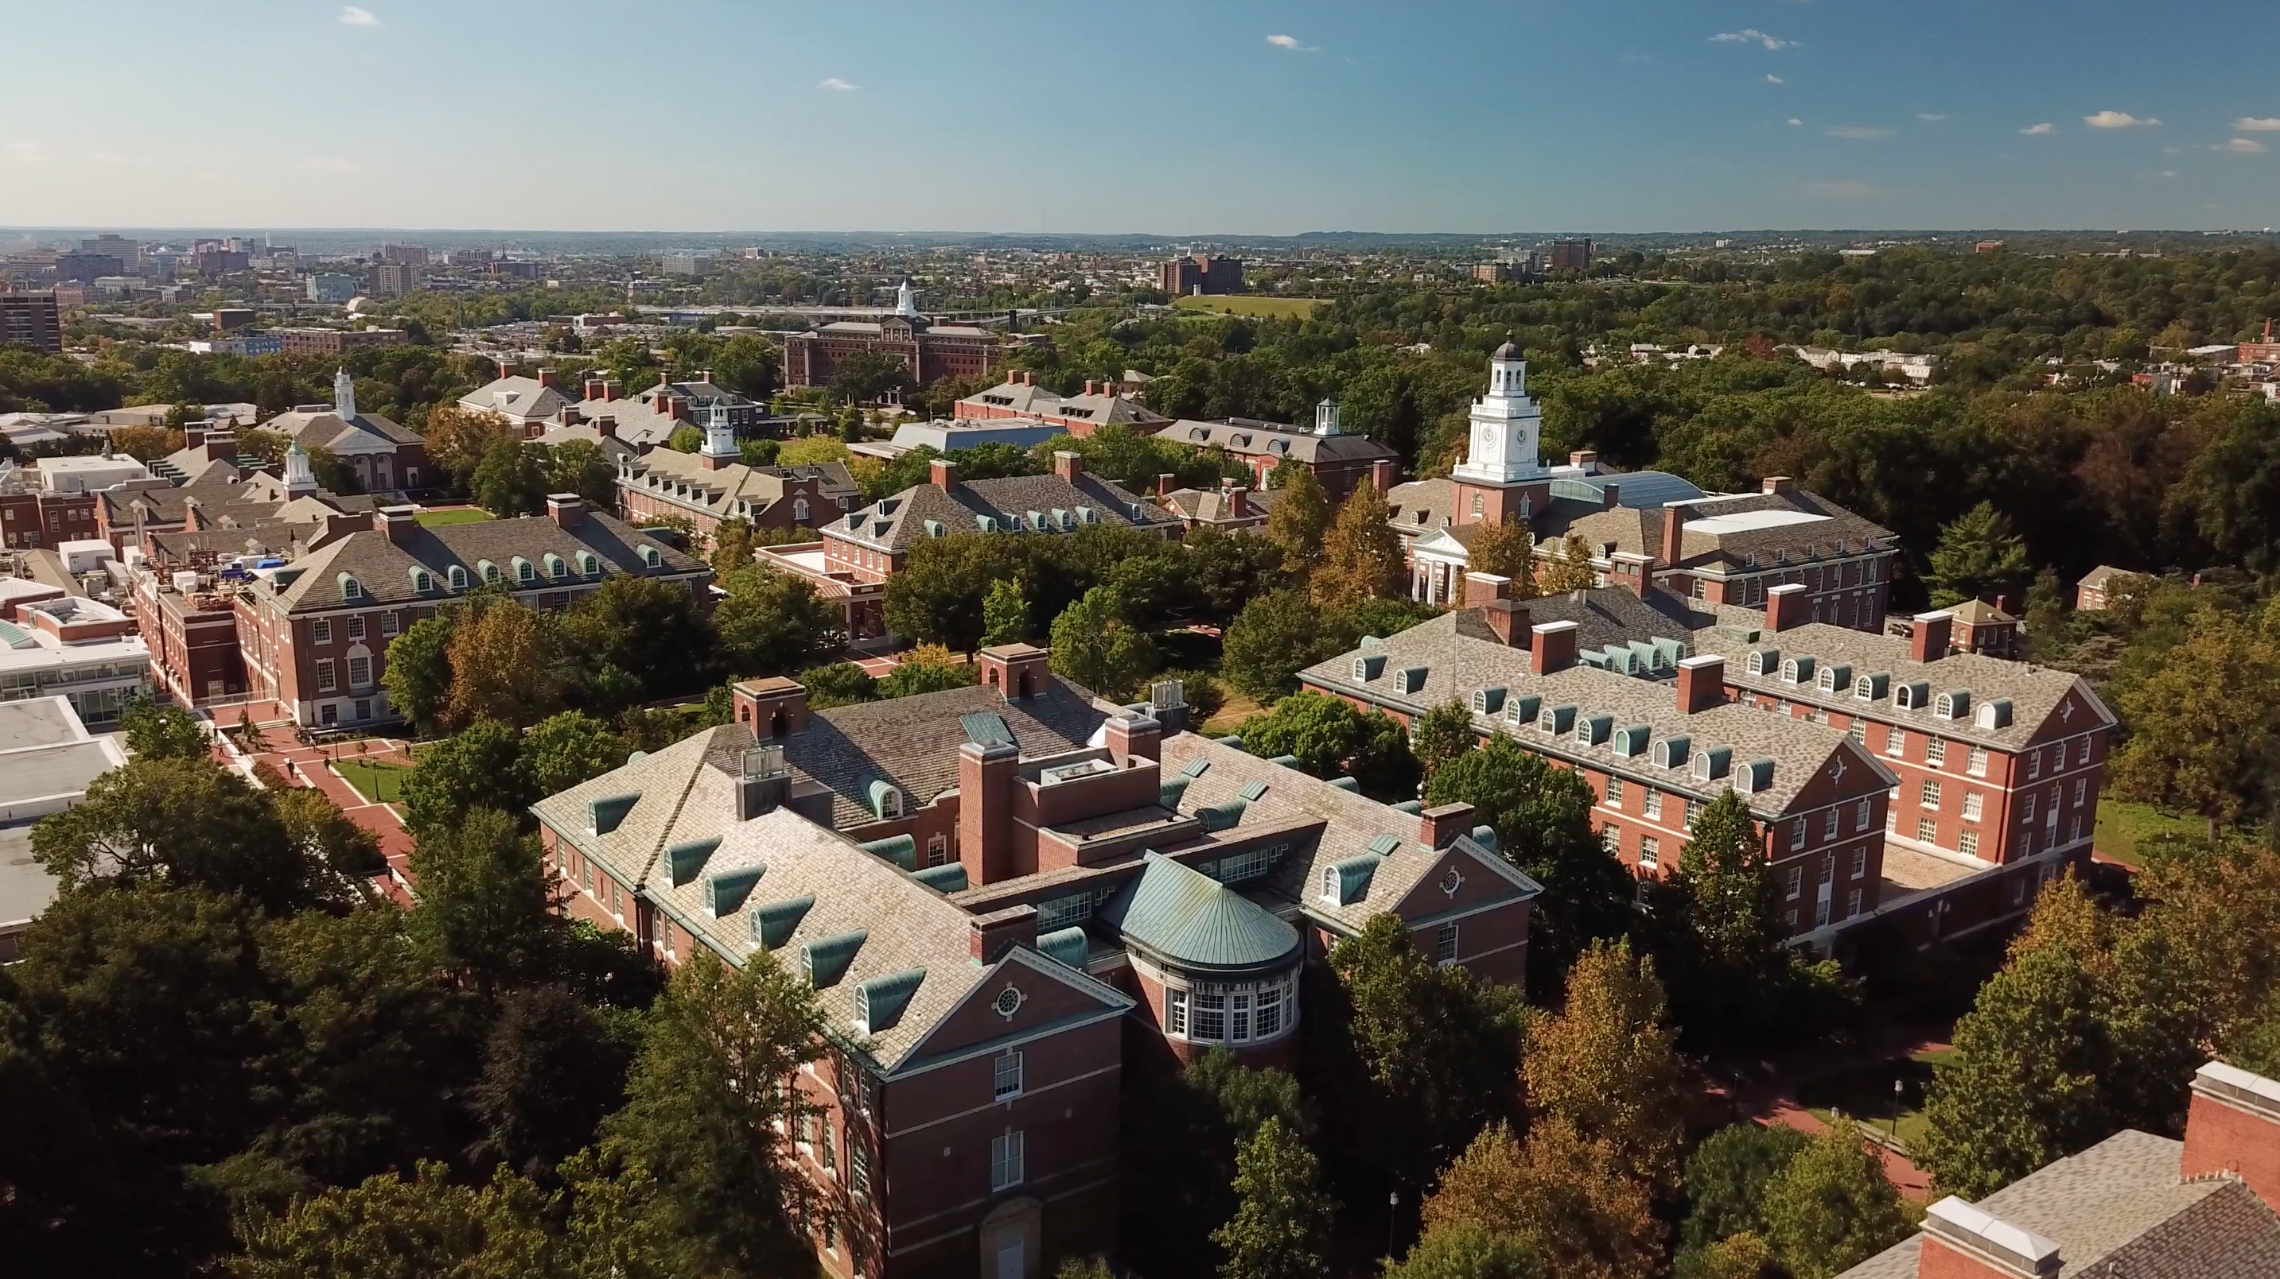

Slide 10
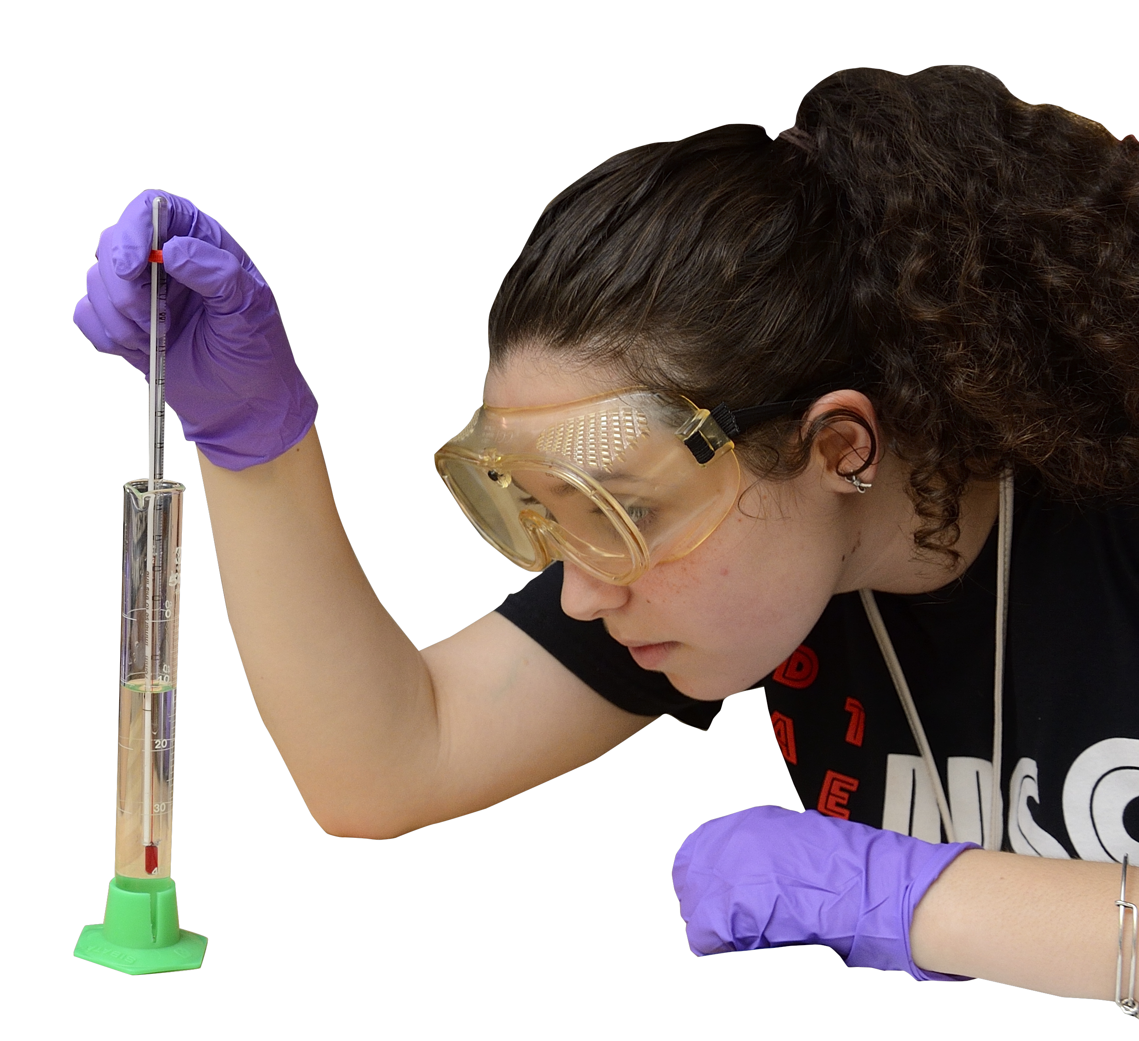
Short Essays
Teacher Recommendation
Transcripts
Test Scores (if available)

Slide 11


Open to current high school
students and recently
graduated seniors
A’s and B’s in high school
math and science classes
Successfully completed Algebra II
Complete a trigonometry course
Successfully completed lab
science courses

Slide 12
Explore Engineering Innovation (In-person/Online)
  In-Person: July 1–26, 2024
  Online: June 24–July 26, 2024
Biomedical Engineering Innovation (Online)
  June 24–August 2, 2024
Sustainable Energy Engineering (In-person)
  July 1–26, 2024

Slide 13


Slide 14
The greatest effect overall that EI had on me was that it confirmed and further cultivated my interest in the creative, problem-solving aspect of engineering… After EI, I knew engineering was the right field for me.”
BMEI challenged me to think critically every single day. No matter the material, the instructors and assignments consistently challenged to me
to think on a deeper level than any courses I’ve ever taken… there is an incredible sense of accomplishment that I really have not experienced anywhere else.”

Slide 15
ei.jhu.edu ei@jhu.edu
2024 Johns Hopkins University. All rights reserved.

